Slide 1
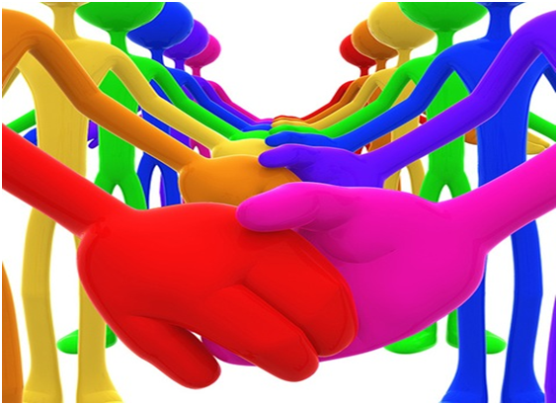
EMOTIONAL INTELLIGENCE AT WORK
Kashif Mohammad Khan

Slide 2
OBJECTIVES
Understand what is Emotional Intelligence.
Understand its benefits and relevance.
How to start developing E.I. skills
Role of E.I. in improving Job Performance for teams & Individuals

Slide 3
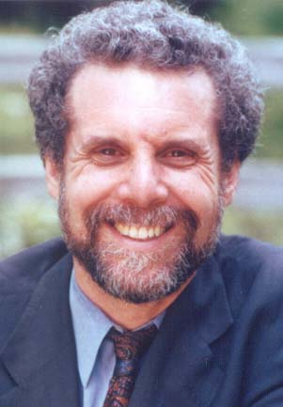
Daniel Goleman considered as the pioneer of E.I.

Slide 4
SIMPLE DEFINITION
“EQ” is the capacity for recognizing our own feelings and those of others, for motivating ourselves, for managing emotions well in ourselves and in our relationships.
Emotional Intelligence
Intrapersonal Intelligence
Interpersonal Intelligence
Being intelligent in identifying our own thoughts and feelings and being effective at dealing with them.
Being intelligent in identifying the thoughts & feelings of others and between others. Effective in tailoring our actions to work with others most appropriately.
Notes:
There are many definitions of EI
The simplest definition is the ability to understand emotions as they happen, and the using that emotion effectively. In other words, managing emotions in yourself and in others, so that you can achieve your goals

Slide 5

What is your feeling if you were one of the two girls? How would you feel if you are the girl in the jeans? Can you relate with this picture?

Slide 6
Case Reference
What would an emotionally intelligent manager do in the case of the previous picture, if they are his/her team members and there exist a gap between them.
HINT ! Definition discussed..

Slide 7
You are in a meeting when a colleague takes credit for the work you have done. What do you do?
SITUATION
Immediately confront the colleague saying that you did the research?
After the meeting, take the colleague aside & tell him/her that in the future you would appreciate credit for the work you did.
Nothing. It’s best not to embarrass colleagues in public.
After the colleague speaks, publicly thank him/her for referencing your work & provide additional details about the work.

Slide 8
You find out that the promotion you were hoping for, was given to someone else.
SITUATION
Your Response:
You forget about it. You didn't want the job that much anyway.
You lock yourself in your office and cry.
You obsess over what the other person had that you didn't and compare yourself to him or her unmercifully.
You continue to do your best; you know the next promotion is yours.

Slide 9
Any other better solution
In terms of Emotional Intelligence:
You need to keep in mind that E.I. involves both your’s and other’s emotional need.

Slide 10
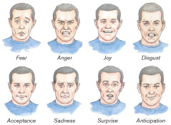
What are Emotions
An emotion involves physiological change, expressive behavior and non verbal expression

Slide 11
Dealing with Emotions
1- Facilitative Emotions:
Contribute to effective functioning.
Examples: ………
2- Debilitative Emotions:
Hinder or prevent effective interpersonal communication.
Examples: …….
Characteristic: Long duration and affects clarity of mind.

Slide 12
Common Example
You are having difficult time dealing with your Supervisor lately. As he walks out Friday evening leaving his office for home, comes back to your table and says I need to see the register and file first thing Monday morning.
What will be the impact of this conversation on you?

Slide 13
Coping with Emotions
Activating Event | Thought or Belief | Consequences
Being called names | I’ve done something wrong | Hurt, upset
Being called names | My friend is mentally ill | Pity, sympathy

Slide 14
Coping with Emotions CONCLUSION
Learning to monitor your self-talk or Thought / Belief can help you learn that how you deal with your emotions.
Example:
As discussed in the case of Supervisor.

Slide 15
Test of IQ
You Tube Clip, 10 second IQ TEST.

Slide 16
Emotional Intelligence
IQ is important to get the job one desire but to stay successful in the organization one needs to be emotionally intelligent.

Slide 17
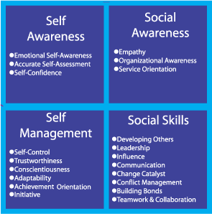
INTERRELATION OF EMOTIONAL INTELLIGENCE COMPETENCIES

Slide 18
EI WORTH?
* Could increase production as much as 20%.
Current estimates to American Business: Losing between $5.6 and $16.8 Billion annually.
^ If we knew nothing about a store except that employee attitudes had improved 5%, we could predict that its revenue would rise 0.5% above what it otherwise would have been.
* Cherniss, C. and Goleman, D. (1998). Bringing emotional intelligence to the workplace. Available from www.eiconsortium.org.
^ Byron Stock & Associates. Emotional Intelligence, Getting to the heart of performance. American Society for Training and Development International Conference, Atlanta, GA, June 1999.
Notes:
Box 1: Von Hoffman, C. (June, 1999). Crabs, cranks. and curmudgeons. How to manage difficult people. Harvard Management Update, 4-5. --It says, “Increases retention.
Decreases absenteeism.
Increases overall organizational growth.”
Box 2: Cherniss, C. and Goleman, D. (1998). Bringing emotional intelligence to the workplace. A technical report issued by the Consortium for Research on Emotional Intelligence in Organizations. Available from: www.eiconsortium.org.
Box 3: Byron Stock & Associates. Emotional Intelligence, Getting to the heart of performance. American Society for Training and Development International Conference, Atlanta, GA, June 1999.

Slide 19
EI WORTH
Hallmark Communities sales staff who developed emotional intelligence were 25% more productive than their low EQ counterparts.
Coca-Cola saw division leaders who developed EQ competencies outperform their targets by more than 15%.
Division leaders who didn’t develop their EQ missed targets by the same margin (McClelland, 1999).

Slide 20
HOW WE CAN IMPROVE EI?
Facial Expressions
Body Movements
Eye Behavior
Paralanguage
Physical Appearance
Leadership Styles
Perceiving: Recognizes what events are likely to trigger different emotions
Understanding: Know that emotions can combine to form complex blends of feelings
Managing: Realizes that emotions can progress over time and transition from one to another
Using: Greater precision in operating feelings and blends of feelings according to your needs.
Notes:
Mayer and Salovey

Slide 21
You Tube Clips
Non-Verbal communication Eye Contact
and Facial feedback.

Slide 22
Test your Emotional Intelligence (EQ) Applied cases for Improving Emotional Intelligence
Interactive Discussion on different situations of Life to develop E.I. understanding.
Individual and Group discussion on how to deal with different types of Situation and consequences of our decisions.

Slide 23
IN ESSENCE
The rules for work are changing. We’re being judged by a new yardstick: not just by how smart we are, but by how we handle ourselves and each other.
Daniel Goleman, Working with Emotional Intelligence, 1998

Slide 24
Process & development of Individual, Team and Organizational Emotional Intelligence.

Slide 25
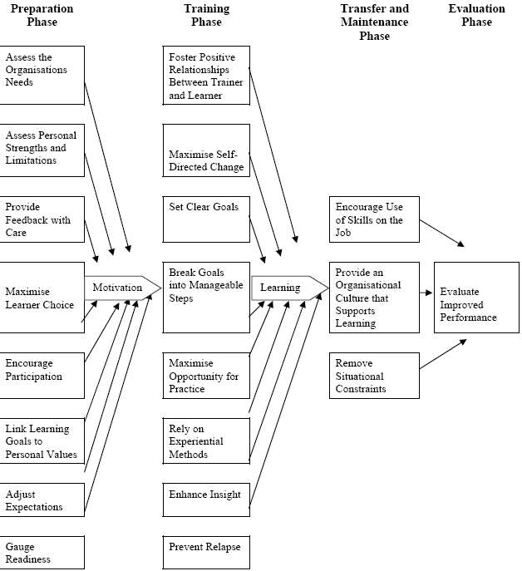

Slide 26
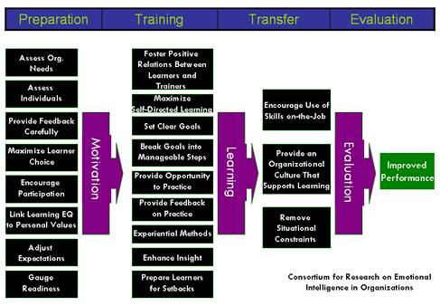

Slide 27
CONCLUSION
Emotional Intelligence is a skill which can be learned from any age.
Organizations have to develop policy and environment to support it.
You can make your life and life of people around you more meaningful by practicing E.I. and make your organization an Emotionally Intelligent organization.

Slide 28
Question Session

